Slide 1
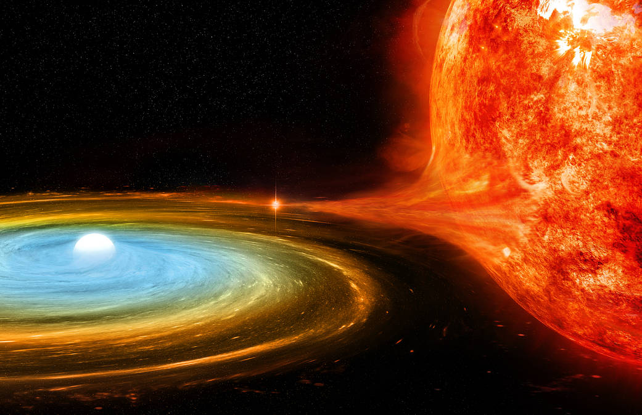
Towards improved theoretical rates of nova and type Ia supernova events through population synthesis
Alex Kemp, PhD candidate
Supervised by Amanda Karakas, Andy Casey
School of Physics & Astronomy, Monash University
Image:: NASA/CXC/M.Weiss

Slide 2
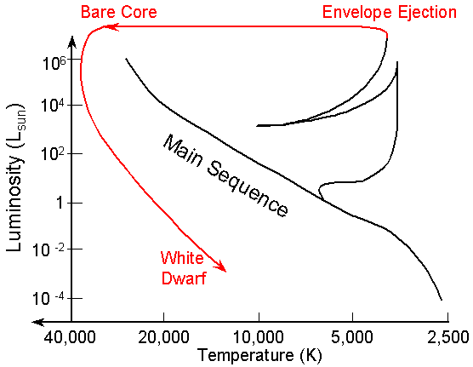
What is a white dwarf?
An inert, exposed stellar core supported by electron degeneracy pressure
Image: Prof. Richard Pogge

Slide 3
What can they do?
Explode in a type Ia SN.
Erupt in nova explosions.
Collapse into a neutron star (AIC).
Change their composition?
C/O -> O/Ne WD?
Image: Sky & Telescope

Slide 4
What can they do?
Explode in a type Ia SN.
Collapse into a neutron star (AIC).
Erupt in nova explosions.
Change their composition?
C/O -> O/Ne WD?
Notes:
https://astrobites.org/2015/04/07/super-bright-supernovae-are-single-degenerate/
^image page

Slide 5
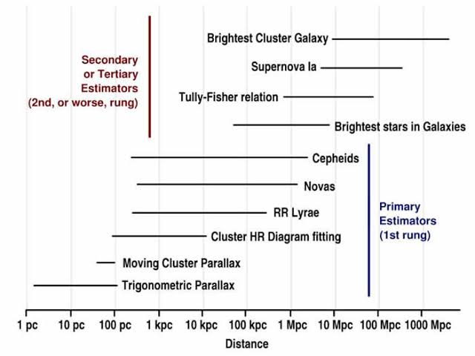
Wider implications: cosmology
Type Ia supernovae form an important rung on the cosmic distance ladder…
Image: Brian Koberlein

Slide 6
Wider implications: cosmology
Type Ia supernovae form an important rung on the cosmic distance ladder…
...But we don’t really understand their progenitors
Image: Brian Koberlein
Image: Sky & Telescope
Notes:
Phillips relation
In astrophysics, the Phillips relationship is the relationship between the peak luminosity of a Type Ia supernova and the speed of luminosity evolution after maximum light.

Slide 7
Wider implications: nucleosynthesis
Type Ia supernovae are also extremely important to galactic chemical evolution due to their role in iron production.
Nova systems are sites for unique nucleosynthesis of lighter elements (eg.¹³C, ¹⁵N, ¹⁷O)
Image: Christina Chiappini

Slide 8
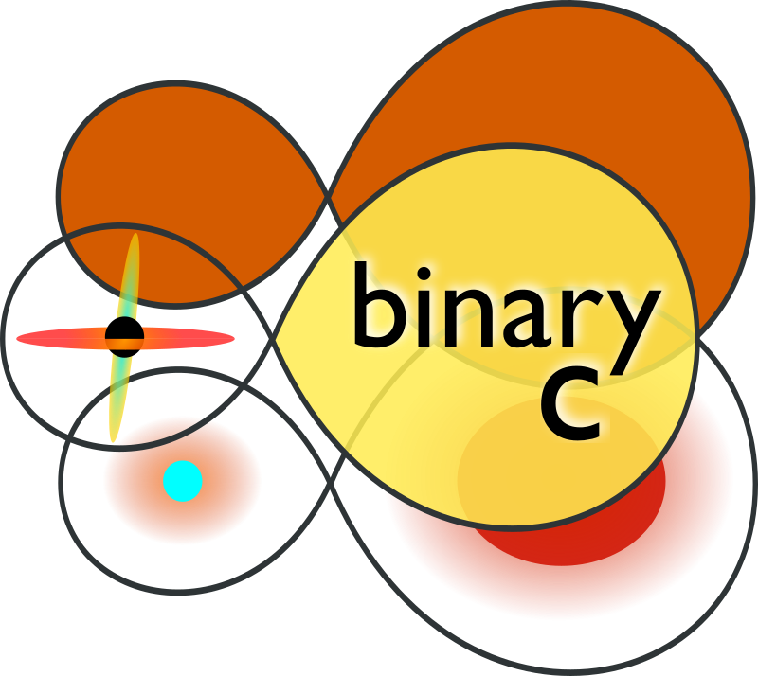
My work
Population synthesis code
Rapid evolution of many non-interacting binaries
Uses interpolations and fitting formulae to the results from detailed models
Study the effect of the results (and uncertainties!) of detailed models on population statistics; how well can we predict rates?
Notes:
https://astrobites.org/2015/04/07/super-bright-supernovae-are-single-degenerate/
^image page

Slide 9
My work
I study accreting white dwarfs using using the population synthesis code binary_c (Izzard et al. 2004)
Population synthesis codes rapidly evolve many isolated binary systems
binary_c is specialized towards the evolution of low-mass stars
Objective: study the effect of the results (and uncertainties!) of detailed models on population statistics. How well can we predict rates?

Slide 10
Towards improved theoretical rates of novae and type Ia supernova events through population synthesis
We would like to:
Record individual nova events
Compare different evolutionary pathways to events such as novae, type Ias, and AICs.
Explore the impact of some of the key uncertainties (eg. Common envelope treatment, accretion efficiency)

Slide 11
Towards improved theoretical rates of nova and type Ia supernova events through population synthesis
Track individual nova events
Consistently treat H and He accretion based on modern detailed models
Include the double detonation channel for type Ia supernovae.

Slide 12
Structure of a white dwarf
H layer
He layer
C/O or O/Ne Core
Unknown artist, North Arizona Univerisity

Slide 13
The three pillars
Accretion
regime
Critical ignition mass
Accretion
efficiency

Slide 14
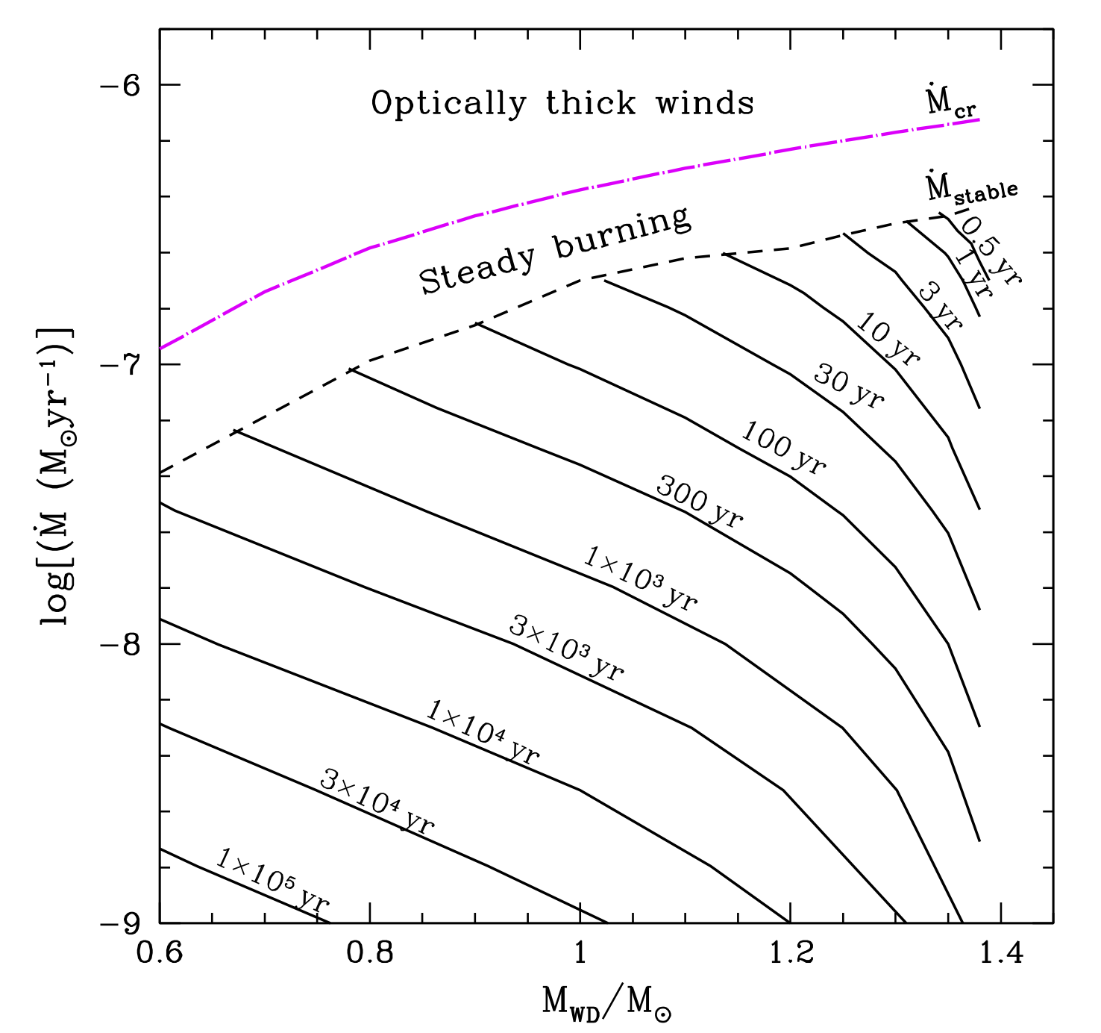
The three pillars: accretion regime
Accretion
regime
Critical
H layer mass
Accretion
efficiency
Image: Kato et al 2014

Slide 15
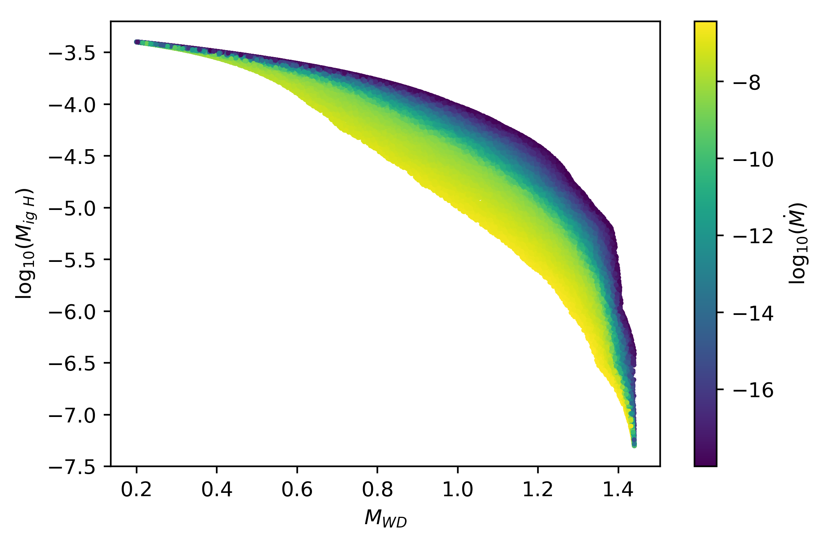
The three pillars: critical ignition mass
Accretion
regime
Critical
H layer mass
Accretion
efficiency
Using data from Kato et al 2014

Slide 16
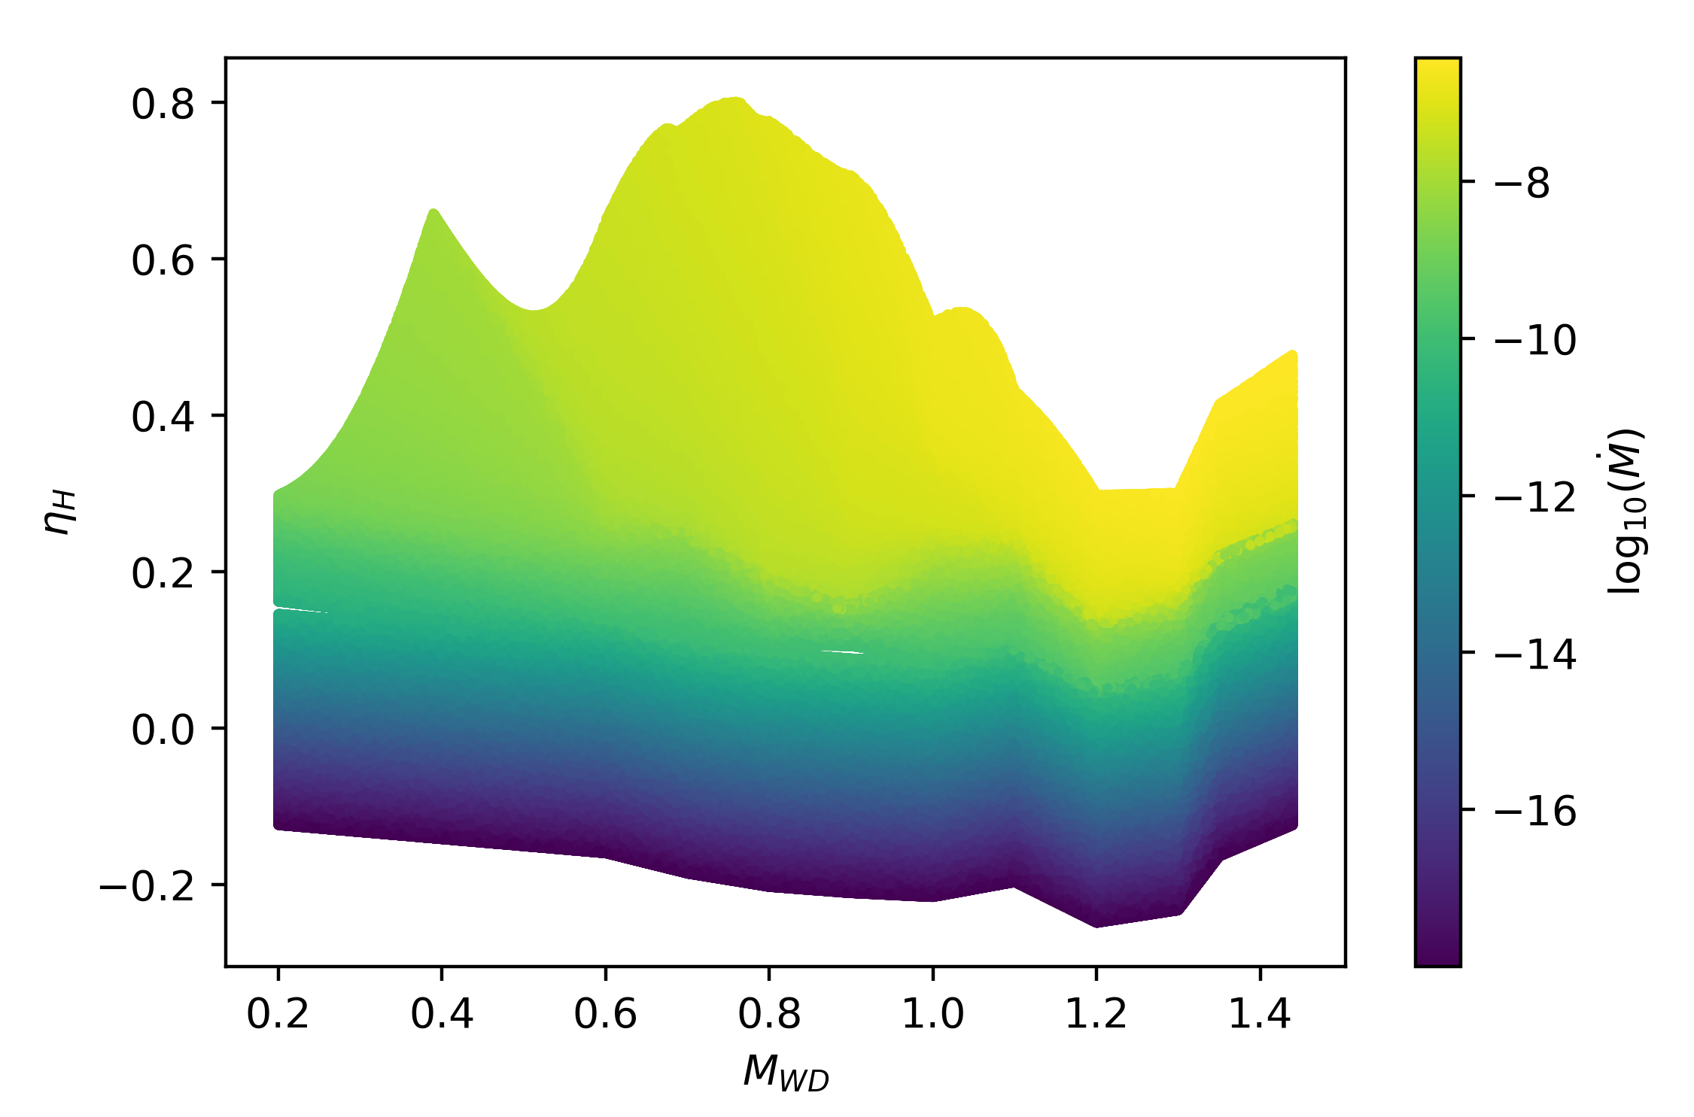
The three pillars: accretion efficiency
Accretion
regime
Critical
H layer mass
Accretion
efficiency
Using data from Wang et al 2018

Slide 17
Example H nova scenario: H donor, WD accretor.
H layer
H accretion @ rate Ṁ
He layer
C/O or O/Ne Core
C/O or O/Ne Core

Slide 18
Check accretion regime
H layer
Check accretion regime
Giant?
Steady burning?
Novae?
H accretion @ rate Ṁ
He layer
C/O or O/Ne Core
C/O or O/Ne core
Mass

Slide 19
Steady H burning regime.
H layer
Check accretion regime
Giant?
Steady burning?
Novae?
H layer
H accretion @ rate Ṁ
He layer
He layer
C/O or O/Ne Core
C/O or O/Ne core
Mass

Slide 20
Unsteady H burning regime
H layer
Check H accretion regime
Giant?
Steady burning?
Novae?
H layer
H accretion @ rate Ṁ
He layer
He layer
C/O or O/Ne Core
C/O or O/Ne core
Mass

Slide 21
Compute critical ignition mass
H layer
Compute critical H layer mass
H accretion @ rate Ṁ
M_{crit}
He layer
H layer
C/O or O/Ne Core
C/O or O/Ne core
Mass

Slide 22
Check H layer mass against M_{crit}
H layer
Compute critical H layer mass
H accretion @ rate Ṁ
M_{crit}
He layer
H layer
C/O or O/Ne Core
C/O or O/Ne core
Mass

Slide 23
Compute the accretion efficiency
H layer
Compute H accretion efficiency
H accretion @ rate Ṁ
He layer
H layer
ΔM_{retained}
C/O or O/Ne Core
Back accretion
C/O or O/Ne core
Mass
ΔM_{lost}

Slide 24
A quick word on type Ias
Double degenerate
Single degenerate
Single degenerate, double detonation
Image: Piersanti et al, 2014
Image: Sky & Telescope

Slide 25
What I’ve talked about
Broad importance of accreting white dwarfs
Overview of my current work
My model’s treatment of H accretion onto a C/O or O/Ne white dwarf

Slide 26
What you should talk to me about
Donor composition (Z, He vs H)
Accretor composition (He, C/O, O/Ne)
WD mergers, AIC->NS, Type Ia channels, C/O WD - > O/Ne WD
Planetary nebulae
V445 Puppis, first He nova
Image: ESO

Slide 27
Critical Physical Variables
Nature (?)
WD mass
WD composition
Accretion rate Ṁ
Donor composition
WD Temperature
Notes:
https://astrobites.org/2015/04/07/super-bright-supernovae-are-single-degenerate/
^image page

Slide 28
Critical Physical Variables
Nature (?)
☠️ Model treatment☠️
WD mass
WD composition
Accretion rate Ṁ
Donor composition
WD Temperature
Tracked and used ✓
C/O, O/Ne ✓
RLOF and winds ✓
H-rich or He-rich, Z=0.02, e-4?✓
Tracked (basic), not used ✗
Notes:
https://astrobites.org/2015/04/07/super-bright-supernovae-are-single-degenerate/
^image page

Slide 29
AIC->NS
BSE (Hurley et al,2002)
ONeWD + M_WD=>M_{Ch} = AIC->NS
☠️Model treatment☠️
Unchanged
Nature (?)
Uncertain.
May collapse, may partly explode
Notes:
https://astrobites.org/2015/04/07/super-bright-supernovae-are-single-degenerate/
^image page

Slide 30
Type Ia SNe
BSE (Hurley et al,2002)
COWD + M_WD=>M_{Ch} = Type Ia
Distinguish DD, SD channel
☠️Model treatment☠️
+ Double Detonation mechanism (sub-M_{Ch})
(CO and ONe WDs)
Nature (?)
Debatable whether DD and sub-M_{Ch} always explode
Notes:
https://astrobites.org/2015/04/07/super-bright-supernovae-are-single-degenerate/
^image page

Slide 31
Novae 1
BSE (Hurley et al,2002)
Tracks novae conditions based on a flat Ṁ threshold
Accretion efficiencies set directly as a desired constant.
No distinction between H, He donors.
No distinction between CO or ONe WDs
☠️Model treatment☠️
Track individual nova events.
Event trigger based on Ṁ and M_{WD}
Nature (?)
Debatable whether DD and sub-M_{Ch} always explode
Notes:
https://astrobites.org/2015/04/07/super-bright-supernovae-are-single-degenerate/
^image page

Slide 32
Novae 2
☠️Model treatment☠️
Track individual nova events.
Event trigger and accretion efficiency based on Ṁ and M_{WD}
Different fits for H and He donors.
COWDs and ONeWDs treated the same.
Nature (?)
Major uncertainties concern mixing and efficiencies
Fast vs slow novae
Notes:
https://astrobites.org/2015/04/07/super-bright-supernovae-are-single-degenerate/
^image page

Slide 33
What you get
The ability to count nova eruptions.
Better WD mass growth
Notes:
In 2012, when taking high resolution spectra of stars in NGC 2419, Cohen and Kirby found that there appeared to be two populations of stars in the cluster characterized by their Mg and K abundances…
We currently have no explanation for the existence of this population of stars.

Slide 34
What you pay
To ensure you ‘catch’ all the nova erruptions, it is necessary to limit the physical timestep used by binary_c to a fraction of the recurrence time.
Notes:
In 2012, when taking high resolution spectra of stars in NGC 2419, Cohen and Kirby found that there appeared to be two populations of stars in the cluster characterized by their Mg and K abundances…
We currently have no explanation for the existence of this population of stars.

